Slide 1
Intro to Linux
@LegendaryPatMan
Paddy@legendary.industries

Slide 2
Topics Covered
What is Linux?
Linux Concepts
The CLi
Why should you get used to Linux?
Sources & Resources
Q&A

Slide 3
What is Linux?

Slide 4
Windows
Windows is a family of operating systems built around the NT kernel
Windows comes in different forms known as Versions
Each Version has a Series which change it’s feature set
  Enterprise, Pro, Home etc

Slide 5
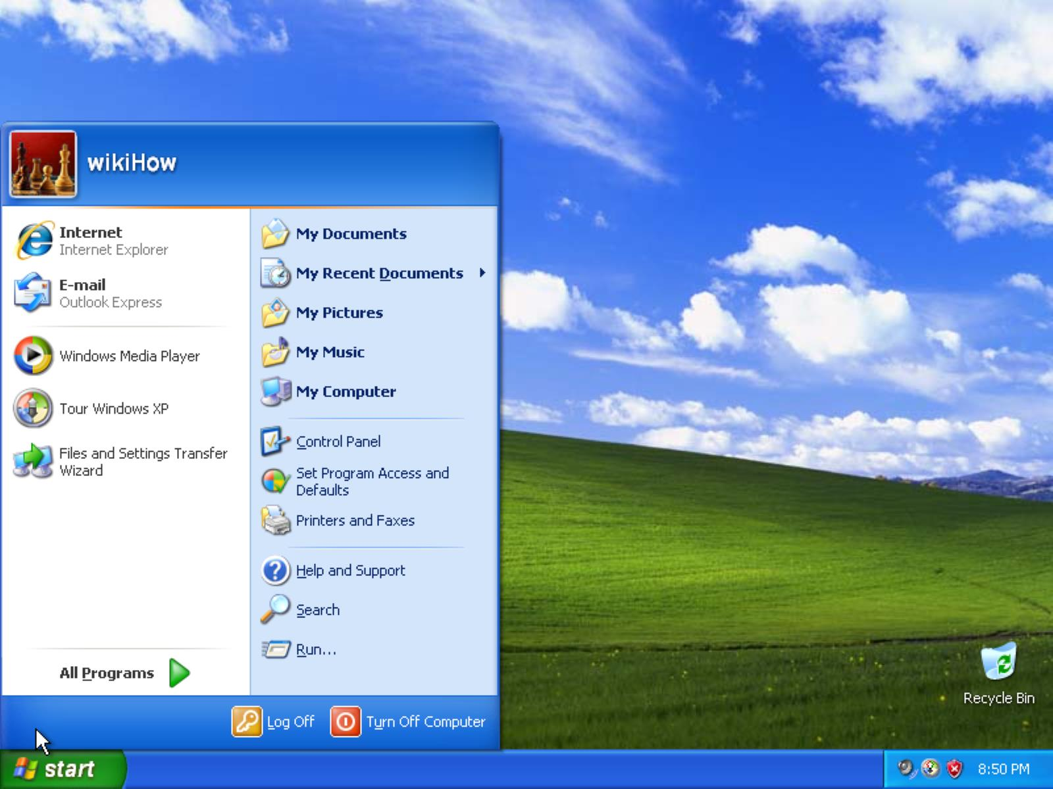
Windows XP

Slide 6
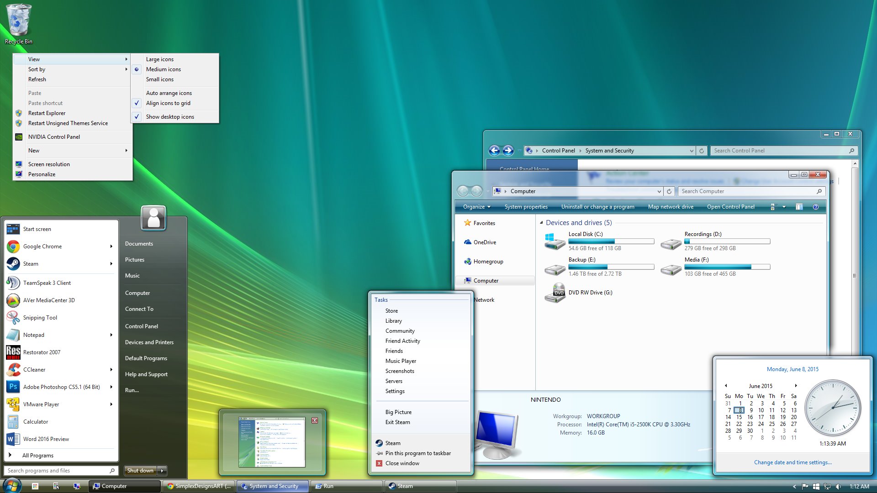
Windows Vista

Slide 7
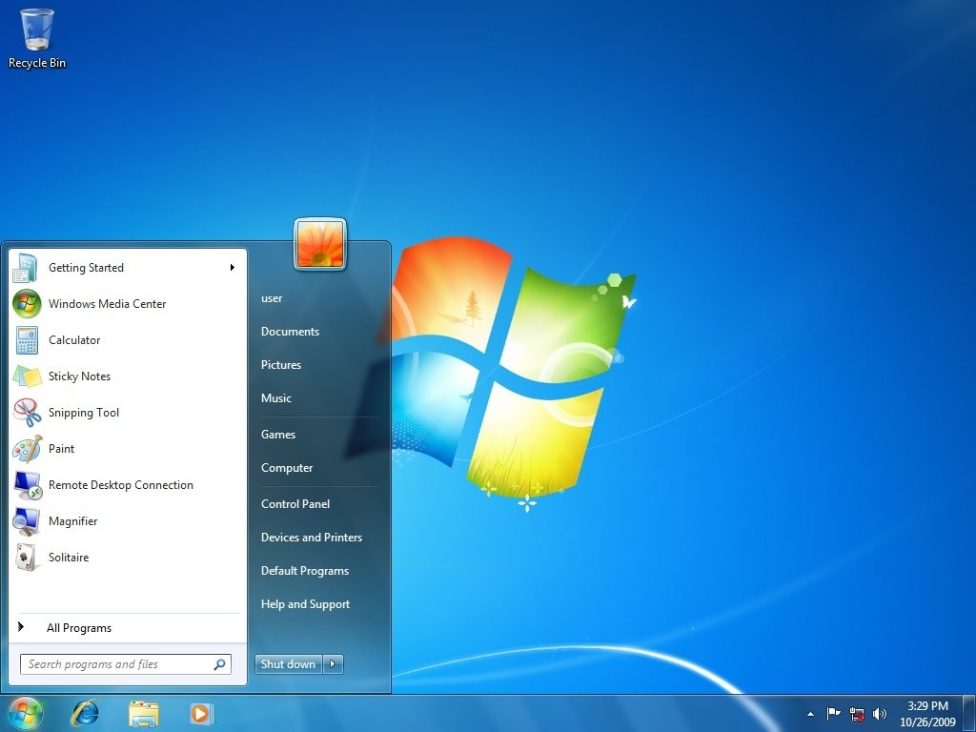
Windows 7

Slide 8
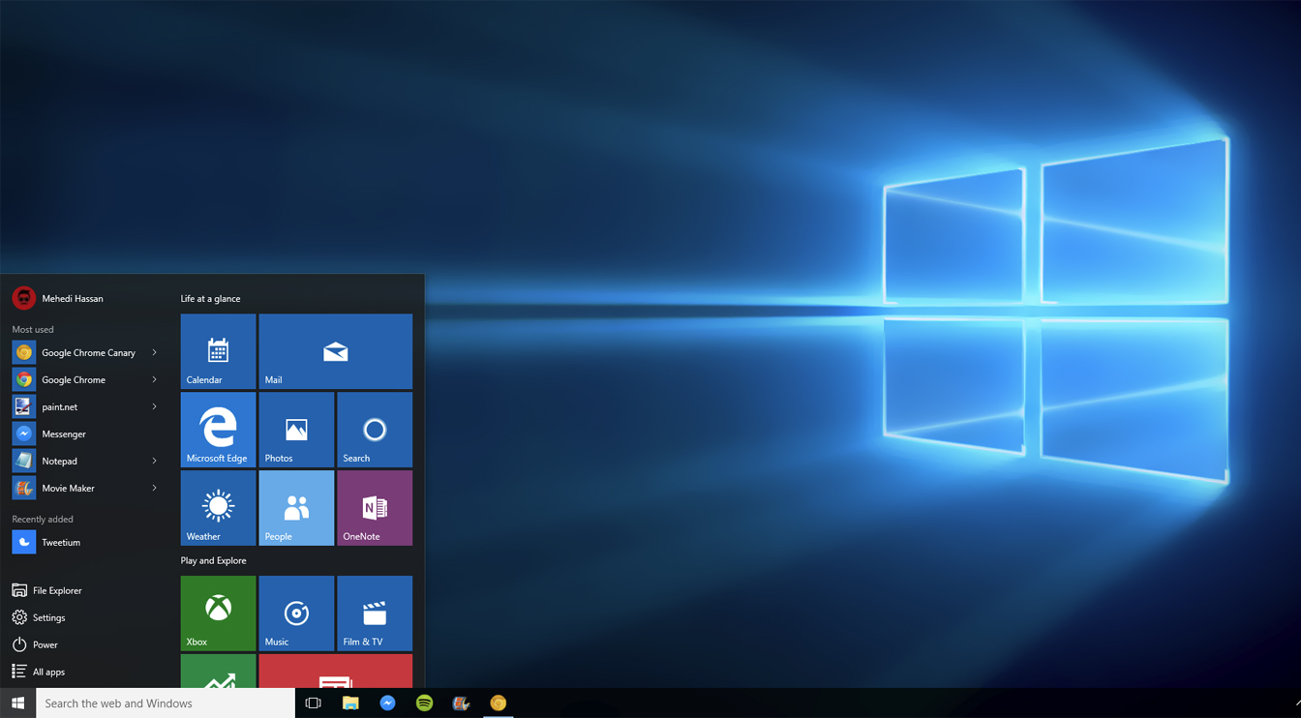
Windows 10

Slide 9
So how does this compare to Linux?

Slide 10
What is Linux?
Linux is a family of free and open-source software operating systems built around the Linux kernel
Linux comes in different forms known as Distros
Each Distro has flavours which change how it looks

Slide 11
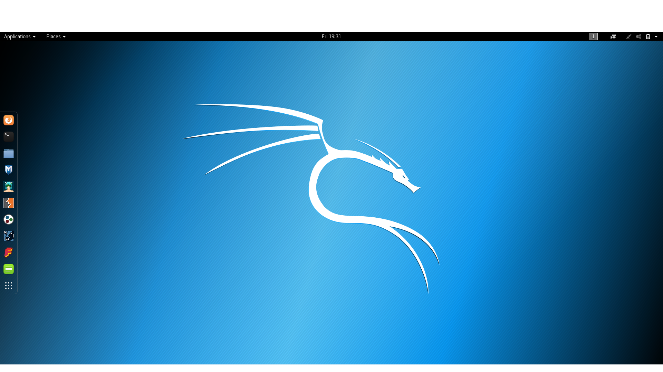
Kali Distro

Slide 12
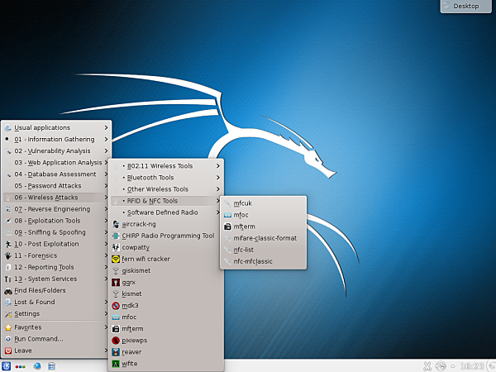
KDE Flavor

Slide 13
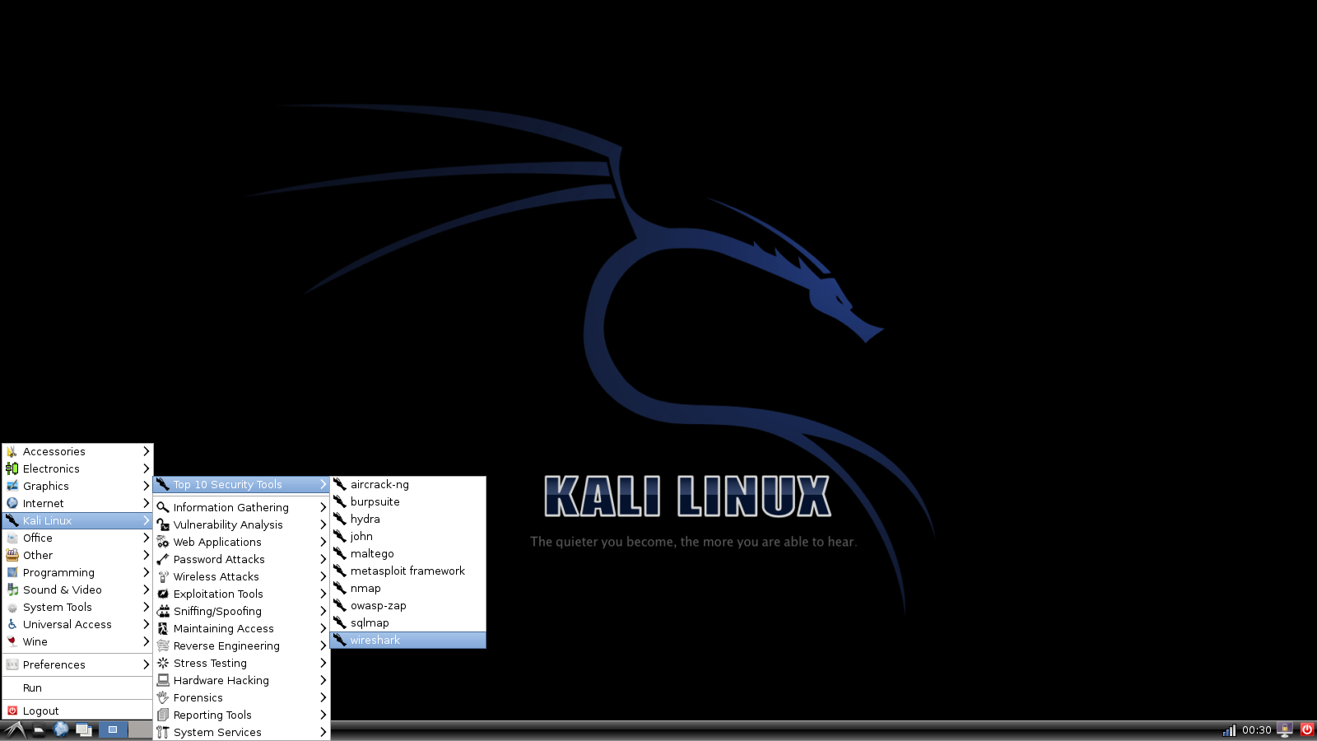
LXDE Flavor

Slide 14
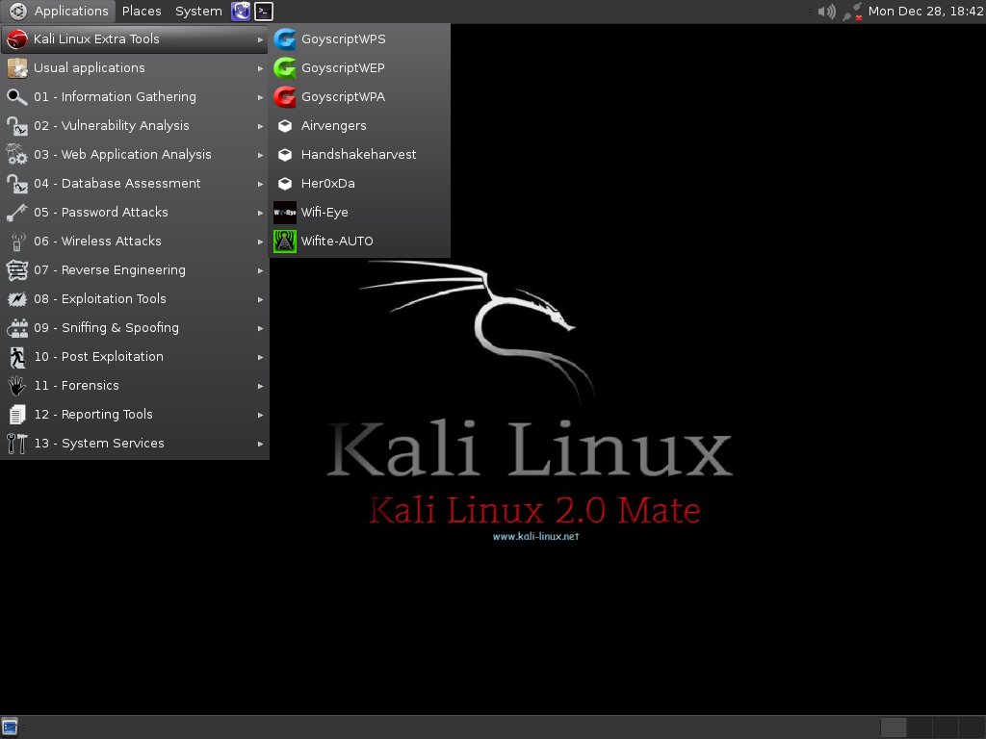
MATE Flavor

Slide 15
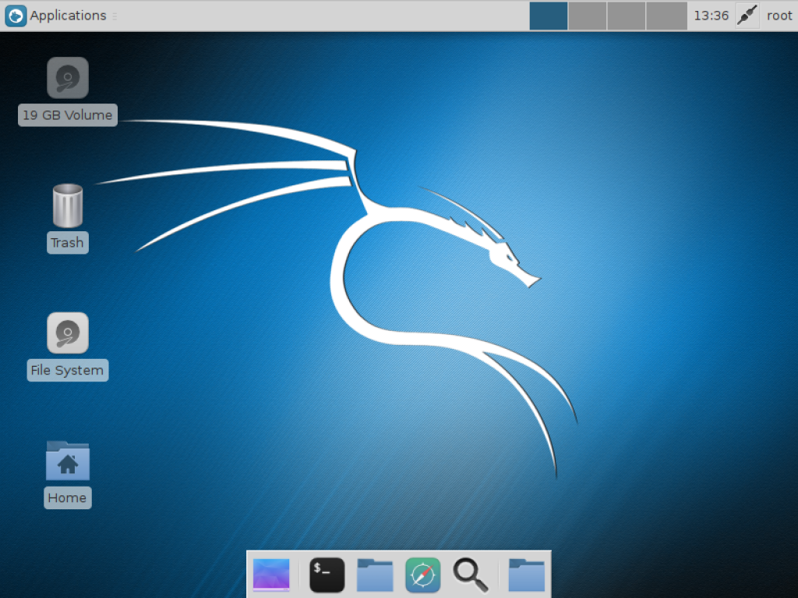
XFCE Flavor

Slide 16
Linux Concepts and Comparisons to Windows

Slide 17
Free and Open Source
Free as in no cost
AND/OR
Free as in Freedom
AND
Source Code is shared

Slide 18
Free Software's Four Freedoms
1. The unlimited use for any purpose
2. The right to study how the program works and understand it
3. The right to share copies of the software
4. The freedom to improve the program and to distribute the improvements to the program
https://fsfe.org/freesoftware/basics/4freedoms.en.html

Slide 19
udev
Device Manager
Provides a set of generic open source drivers to makes any hardware work with your install
Ensures that hardware just works when you plug it in

Slide 20
Hardware Support
Works on anything
Support on nearly every device from 1991 to now, and older even stuff you’ve never heard of like Itanium, RISC-V and Sparc

Slide 21
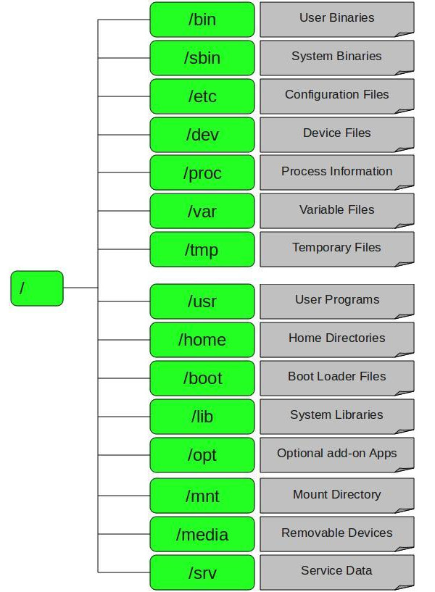
FHS
Logical layout of files in Linux
Done so:
  Software knows where other software is
  So the user can find files in the system

Slide 22
Data Mobility
You can copy paste your home folder to a new linux install and everything just works
You can even install /home as a partition and change your Linux install without issues
All thanks to the FHS

Slide 23
Choice of Run Level
The mode of operation
0-6 depending on what you need
  0 is shutdown/ halt 6 is reboot
  1 is rescue, no reboot required
  2 and 3 are CLi only
  5 is GUI

Slide 24
Security
Being open, everyone knows how a give piece of software works
Patches are written, tested deployed in hours to users

Slide 25
Privacy
The Linux platform does not collect user data. Period.

Slide 26
The CLi

Slide 27
Why?!
A lot of tools you’ll use over time are CLi only
  airmon-ng, aircrack-ng, recon-ng, r2
Some things in courses are CLi only
In the real world, a lot of work is done in the CLi, espescially on servers even on Windoze
Get used to it now rather than later

Slide 28
A note on $ and #
$ == regular user
# == root/superuser
root/superuser is the admin
sudo <cmd> to run commands as root
su root to switch user to root

Slide 29
Getting Help
ls --help
man ls
info ls

Slide 30
Creating and modifying files
touch - Create a file
rm - Delete a file with a warning
rm -rf - Delete a file without warning

Slide 31
Text Editors
nano - A simple text editor
vim - A a black hole from which you will never emerge
  :q to quit
emacs - A whole operating system

Slide 32
Getting around the file system
pwd == list the current directory
ls == list files in a directory
cd == change directory

Slide 33
pwd
touch abc.txt
nano abc.txt
type a
b
c
d
e
Ctrl-X to save and y to overwrite the file
ls to verify it’s there

Slide 34
Looking at files
cat - Print a file to the CLi
less - Print a file to the CLi in a human readable format
tail - Print the first and last lines of a file
file - Identifies what type of file something is

Slide 35
Searching For Stuff
locate - Locates a file on the system
grep - Search in side files for a particular pattern

Slide 36
cat abc.txt
less abc.txt
q to exit less
tail abc.txt
file abc.txt
cd /
pwd
ls
locate abc.txt

Slide 37
Manipulating files
mkdir - make a directory ie folder
  May require admin permissions so sudo it
cp - Copy file
mv - Move or rename a file
  mv abc.txt abcde.txt to rename
  mv abcde <location> to move

Slide 38
File Permissions
chmod - change file permissions
  chmod -x <filename>
    To make it executable
  chmod 600 ∼/.ssh/authorized_keys
    To make sure that only you can read your SSH keys

Slide 39
Archives and tarballs
.zip, .7z, .rar etc. Generally .tar, sometimes .tgz on Linux systems
tar or .tar.gz – tar is archived gz is compressed
gzip and gunzip can do the same but easier, though it not always installed

Slide 40
tar cvf abcde.txt
  To archive
tar xvf abcde.tar
  To unarchive
tar czvf abcde.txt
  To archive and compress
tar xzvf abcde.tar.gz
  To unarchive and decompress
gzip abcde.txt - To archive and compress
gunzip abcde.gz - To unarchive and compress

Slide 41
Installing Software
dpkg, apt, aptitude and apt-get installed on Kali
apt-get is the most commonly used

Slide 42
sudo apt-get udpate
  To update the cache with updates
sudo apt-get upgrade -y
  To install said updates and bypass warning (-y)
sudo apt-cache search gzip gunzip
  Search for gzip gunzip
sudo apt-get install gzip gunzip
  Install gzip gunzip
apt-get moo
sudo dpkg -i <filename.deb>
  Install .deb files found elsewhere

Slide 43
User Managment
useradd - Add a user
passwd – Change password
  passwd <username> to change someone elses passsord
userdel - Delete a user
usermod - modify a user
  usermod -aG sudo <username> - make user sudo

Slide 44
Doing More
top - displays a task manager
kill - kill a process
  kill <PID>
netstat - display all open network connections

Slide 45
Useful commands
echo - allow you to print strings and variables
&& string two commands together and execute
  sudo apt-get update && sudo apt-get upgrade -y
| - allow you to add an output to a new command
  sudo apt-get --help | grep -i cow
Aliases allow you to shorten commands you use regularly
  alias <ud>=’sudo apt-get update && sudo apt-get upgrade -y’

Slide 46
Being Lazy
1. Use text editors to create files rather than using touch
2. Use tab to finish commands
3. Aliases can be handy to reuse often used commands

Slide 47
Run Levels
runlevel - to show the last and current run levels
init 0 - to shutdown can be poweroff
init 1 - to enter rescue mode
init 3 - to switch to CLi only mode
init 5 - to enter GUI mode
init 6 - to reboot or reboot

Slide 48
Why should you get used to Linux?

Slide 49
It’s part of some courses here
Entire courses in this college are built on it
You’ll have to learn to use it sooner or later
Operating Systems and Professional
Penetration Testing

Slide 50
The world is built on it
60% of web servers
66% of games consoles
80% of mobile phones
99% of super computers
99% of start ups
100% of IoT devices; even microsoft

Slide 51
Governments
Brazil, Russia, China and North Korea are built on Linux
India, France, Germany and Spain have taken huge steps to build on Linux
The European Commission is working to ensure Europe is built on Linux and FOSS

Slide 52
Sources & Resources

Slide 53
Sources
Ten Steps to Linux Survival
https://www.oreilly.com/learning/ten-steps-to-linux-survival
Practical LPIC-1 Linux Certification Study Guide by David Clinton
  https://cloud.legendary.industries/index.php/s/CYPAf7PRtfdnyRX

Slide 54
Good reading
Introducing Linux Distros by Jose Dieguez Castro
  https://www.apress.com/us/book/9781484213933
  https://cloud.legendary.industries/index.php/s/3zsGCybCCmqt4b4
Linux Pocket Guide by Daniel J. Barrett
  https://linuxpocketguide.com/
  https://cloud.legendary.industries/index.php/s/8PFWoQN4ordLz5y

Slide 55
CTF’s
CTF with 34 challenges to teach you the Linux CLI envioment
  http://overthewire.org/wargames/bandit/

Slide 56
Q&A

